Slide 1






Let's
Mind
GAP
THE
&
Talk about
Blockchain
BLOCKCHAIN BOOTCAMP

Slide 2

A blockchain is an open, distributed ledger that can record transactions between two or more parties efficiently and in a verifiable and permanent way without the need for a central authority.
A decentralized computation and information sharing platform that enables multiple authoritative domains, who do not trust each other, to cooperate, coordinate and collaborate in a rational decision making process.
WHAT IS A BLOCKCHAIN?
KEY DISCUSSION POINTS

Slide 3
Because transactions aren’t added to the file individually.
Instead, they are bunched together and added in blocks. Hence, blockchain.
Blocks are linked together, so any changes made to a block lower down the chain will change the blocks above it.
So linked blocks, or blockchain.
WHY IS IT CALLED THE BLOCKCHAIN?

Slide 4
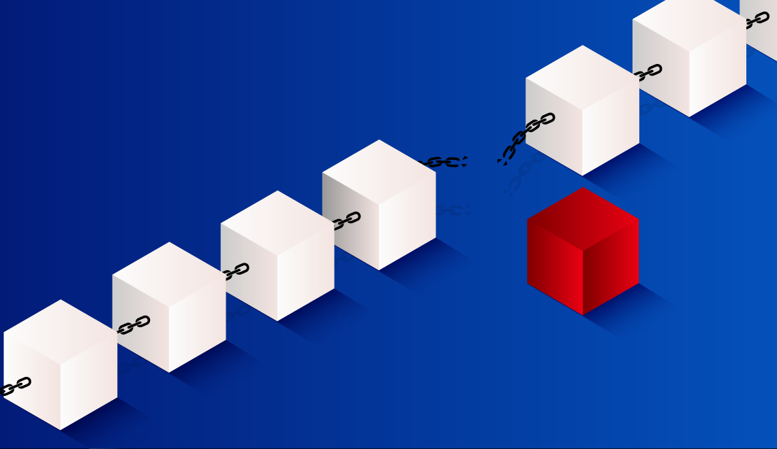

Slide 5
The whole point of using a blockchain is to let people — in particular, people who don't trust one another — share valuable data in a secure, tamperproof way.
— MIT Technology Review
HOW DOES BLOCKCHAIN WORKS?
Blockchain consists of three important concepts:
Blocks,
Nodes and
Miners.

Slide 6

WHAT IS A BLOCK?
Every chain consists of multiple blocks and each block has three basic elements:
The data in the block.
A 32-bit whole number called a nonce. The nonce is randomly generated when a block is created, which then generates a block header hash.
The hash is a 256-bit number wedded to the nonce. It must start with a huge number of zeroes (i.e., be extremely small).
When the first block of a chain is created, a nonce generates the cryptographic hash. The data in the block is considered signed and forever tied to the nonce and hash unless it is mined.

Slide 7
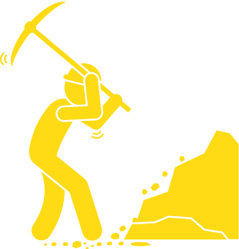
Miners create new blocks on the chain through a process called mining.
In a blockchain every block has its own unique nonce and hash, but also references the hash of the previous block in the chain, so mining a block isn't easy, especially on large chains.
Miners use special software to solve the incredibly complex math problem of finding a nonce that generates an accepted hash. Because the nonce is only 32 bits and the hash is 256, there are roughly four billion possible nonce-hash combinations that must be mined before the right one is found. When that happens miners are said to have found the "golden nonce" and their block is added to the chain.
Making a change to any block earlier in the chain requires re-mining not just the block with the change, but all of the blocks that come after. This is why it's extremely difficult to manipulate blockchain technology. Think of it as "safety in math" since finding golden nonces requires an enormous amount of time and computing power.
When a block is successfully mined, the change is accepted by all of the nodes on the network and the miner is rewarded financially.
WHAT ARE MINERS?

Slide 8
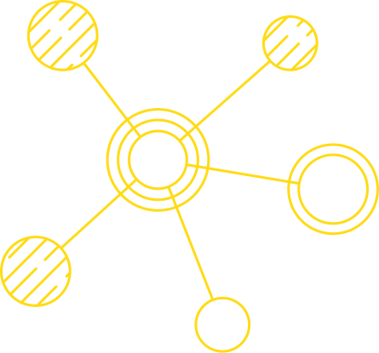
One of the most important concepts in blockchain technology is decentralization. No one computer or organization can own the chain. Instead, it is a distributed ledger via the nodes connected to the chain. Nodes can be any kind of electronic device that maintains copies of the blockchain and keeps the network functioning.
Every node has its own copy of the blockchain and the network must algorithmically approve any newly mined block for the chain to be updated, trusted and verified. Since blockchains are transparent, every action in the ledger can be easily checked and viewed. Each participant is given a unique alphanumeric identification number that shows their transactions.
Combining public information with a system of checks-and-balances helps the blockchain maintain integrity and creates trust among users. Essentially, blockchains can be thought of as the scalability of trust via technology.
WHAT ARE NODES?

Slide 9
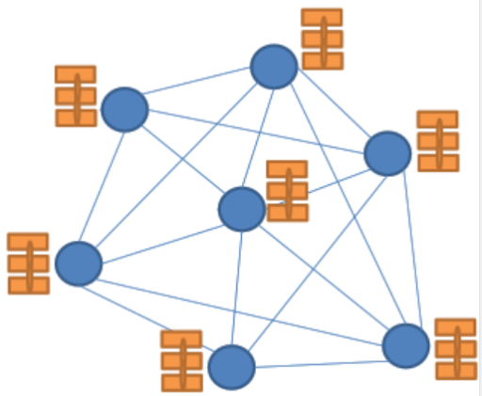

A VERY SIMPLIFIED LOOK OF THE BLOCKCHAIN
Every node maintains a local copy of the global data-sheet
The system ensures consistency among the local copies
The local copies at every node is identical
The local copies are always updated based on the global information

Slide 10

Secure Hashing Algorithm (SHA) -256 is the hash function and mining algorithm of the Bitcoin protocol, referring to the cryptographic hash function that outputs a 256 bits long value. It moderates the creation and management of addresses, and is also used for transaction verification. Bitcoin uses double SHA-256, meaning that it applies the hash functions twice.
The algorithm is a variant of the SHA-2 (Secure Hash Algorithm 2), developed by the National Security Agency (NSA). SHA-256 is also used in popular encryption protocols such as SSL,TLS, SSH and open source operating systems such as Unix/Linux.
The hash algorithm is extremely secure and its workings aren’t known in the public domain. It’s used by the United States government to protect sensitive information, thanks to its ability to verify a content of data without revealing it due to the use of digital signatures. Furthermore, it is also utilized for password verification, since it conveniently does not require the storage of exact passwords, as the hash values can be stored and matched with the user entry to verify if it’s correct or not.
In fact, it is nearly impossible to reveal the initial data from a hash value itself. Moreover, a brute force attack is extremely unlikely to succeed thanks to the astronomical number of potential combinations. In addition, it’s also severely unlikely that two data values (known as collision) have the same hash.
WHAT IS SHA-256?

Slide 11
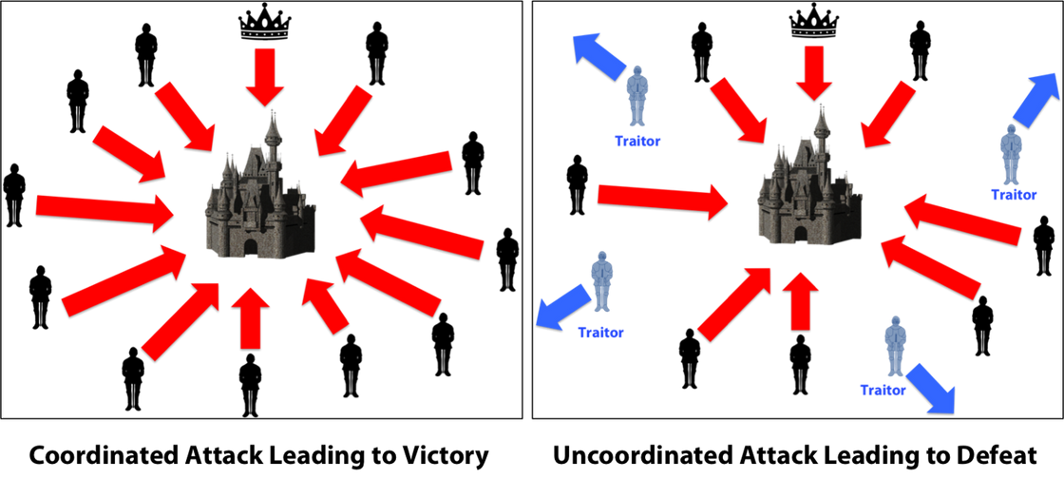

THE BYZANTINE GENERALS PROBLEM
The Byzantine Generals Problem is a game theory problem, which describes the difficulty decentralized parties have in arriving at consensus without relying on a trusted central party. In a network where no member can verify the identity of other members, how can members collectively agree on a certain truth?
The game theory analogy behind the Byzantine Generals Problem is that several generals are besieging Byzantium. They have surrounded the city, but they must collectively decide when to attack. If all generals attack at the same time, they will win, but if they attack at different times, they will lose. The generals have no secure communication channels with one another because any messages they send or receive may have been intercepted or deceptively sent by Byzantium’s defenders. How can the generals organize to attack at the same time?

Slide 12
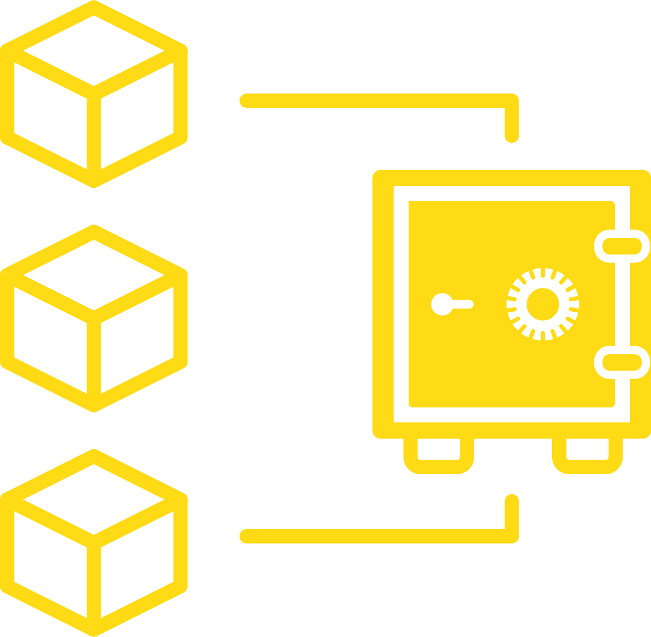
PROOF OF WORK
Proof of work (PoW) describes a system that requires a not-insignificant but feasible amount of effort in order to deter frivolous or malicious uses of computing power, such as sending spam emails or launching denial of service attacks. The concept was subsequently adapted to securing digital money by Hal Finney in 2004 through the idea of "reusable proof of work" using the SHA-256 hashing algorithm.

Slide 13
Bitcoin is a digital currency that is underpinned by a kind of distributed ledger known as a "blockchain." This ledger contains a record of all bitcoin transactions, arranged in sequential "blocks," so that no user is allowed to spend any of their holdings twice. In order to prevent tampering, the ledger is public, or "distributed"; an altered version would quickly be rejected by other users.
The way that users detect tampering in practice is through hashes, long strings of numbers that serve as proof of work. Put a given set of data through a hash function (bitcoin uses SHA-256), and it will only ever generate one hash. Due to the "avalanche effect," however, even a tiny change to any portion of the original data will result in a totally unrecognizable hash. Whatever the size of the original data set, the hash generated by a given function will be the same length. The hash is a one-way function: it cannot be used to obtain the original data, only to check that the data that generated the hash matches the original data.
Generating just any hash for a set of bitcoin transactions would be trivial for a modern computer, so in order to turn the process into "work," the bitcoin network sets a certain level of "difficulty." This setting is adjusted so that a new block is "mined" – added to the blockchain by generating a valid hash – approximately every 10 minutes. Setting difficulty is accomplished by establishing a "target" for the hash: the lower the target, the smaller the set of valid hashes, and the harder it is to generate one. In practice, this means a hash that starts with a very long string of zeros.
UNDERSTANDING PROOF OF WORK

Slide 14
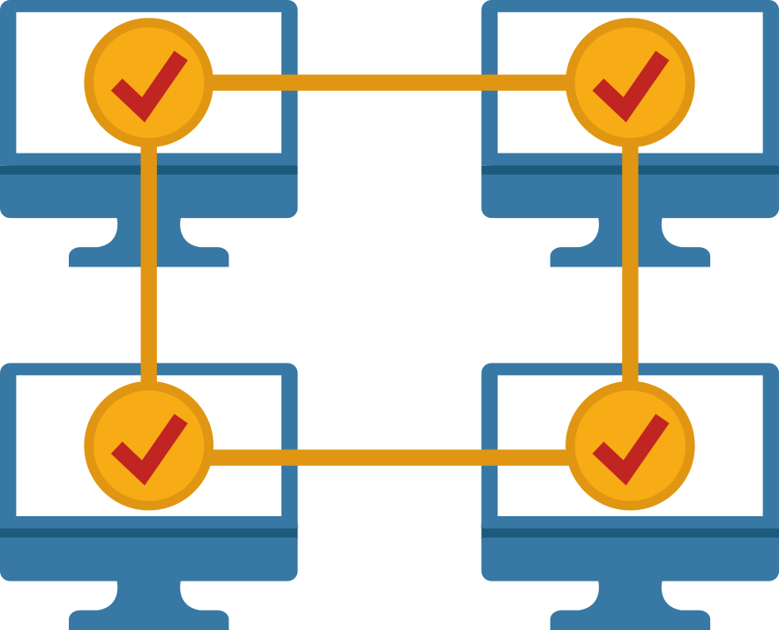
PROOF OF STAKE
The Proof of Stake (PoS) concept states that a person can mine or validate block transactions according to how many coins they hold. This means that the more coins owned by a miner, the more mining power they have.

Slide 15
UNDERSTANDING PROOF OF STAKE
The proof of work (PoW) consensus algorithm requires each node in the Bitcoin network to solve a problem. The first node that solves the problem is granted permission to add a new block and the miners are awarded bitcoin for their work. The nodes are the administrative body of the blockchainand verify the legitimacy of the transactions in each block. Once a block of transactions has been verified, the data is written into the blockchain.
The proof of stake (PoS) consensus protocol was created as an alternative algorithm seeking to address the scalability and environmental sustainability concerns surrounding the proof of work (PoW) protocol.

Slide 16

PROOF OF BURN
Proof of burn is one of the several consensus mechanism algorithms implemented by a blockchain network to ensure that all participating nodes come to an agreement about the true and valid state of the blockchain network. This algorithm is implemented to avoid the possibility of any cryptocurrency coin double-spending.
Proof of burn follows the principle of “burning” the coins held by the miners that grant them mining rights.

Slide 17
Proof of burn (POB) is an alternative consensus algorithm that tries to address the high energy consumption issue of a POW system.
POB is often called a POW system without energy waste. It operates on the principle of allowing miners to “burn” virtual currency tokens. They are then granted the right to write blocks in proportion to the coins burnt.
Iain Stewart, the inventor of the POB algorithm, uses an analogy to describe the algorithm: burnt coins are like mining rigs. In this analogy, a miner burns their coins to buy a virtual mining rig that gives them the power to mine blocks. The more coins burned by the miner, the bigger their virtual mining "rig" will be.
To burn the coins, miners send them to a verifiably un-spendable address. This process does not consume many resources (other than the burned coins) and ensures that the network remains active and agile. Depending upon the implementation, miners are allowed to burn the native currency or the currency of an alternate chain, such as Bitcoin. In exchange, they receive a reward in the native currency token of the blockchain.
You can send out transactions to the network that will burn your own cryptocurrency coins. Other participants can mine/burn on top of your block, and you can also take the transactions of other participants to add them to your block. Essentially, all of this burning activity keeps the network agile, and participants are rewarded for their activities (both burning their own coins and burning other people’s coins).
To prevent the possibility of unfair advantages for early adopters, the POB system has implemented a mechanism that promotes the periodic burning of cryptocurrency coins to maintain mining power. The power of burnt coins “decays” or reduces partially each time a new block is mined. This promotes regular activity by the miners, instead of a one-time, early investment. To maintain a competitive edge, miners may also need to periodically invest in better equipment as technology advances.
UNDERSTANDING PROOF OF BURN

Slide 18
EXAMPLE OF PROOF OF BURN
POB implementation can be customized. For example, Slimcoin, a virtual currency network that uses POB, allows a miner to burn coins that not only gives them the right to compete for the next block but also gives them the chance to receive blocks during a longer time period, for at least a year.
Essentially, Slimcoin’s POB implementation combines three algorithms: POW, POS, and the core POB concept.3 The process of burning coins utilizes POW; the more coins one burns the more chances one has to mine, thus ensuring POS; and the whole ecosystem follows the POB concept.

Slide 19

PROOF OF ELASPED TIME
Proof of elapsed time (PoET) is a blockchain network consensus mechanism algorithm that prevents high resource utilization and high energy consumption and keeps the process more efficient by following a fair lottery system. The algorithm uses a randomly generated elapsed time to decide mining rights and block winners on a blockchain network. By running a trusted code within a secure environment, the PoET algorithm also enhances transparency by ensuring lottery results are verifiable by external participants.

Slide 20
Proof of elapsed time (PoET) is a consensus mechanism algorithm that is often used on the permissioned blockchain networks to decide the mining rights or the block winners on the network. Permissioned blockchain networks are those which require any prospective participant to identify themselves before they are allowed to join. Based on the principle of a fair lottery system where every single node is equally likely to be a winner, the PoET mechanism is based on spreading the chances of winning fairly across the largest possible number of network participants.
The working of the PoET algorithm is as follows. Each participating node in the network is required to wait for a randomly chosen time period, and the first one to complete the designated waiting time wins the new block. Each node in the blockchain network generates a random wait time and goes to sleep for that specified duration. The one to wake up first—that is, the one with the shortest wait time—wakes up and commits a new block to the blockchain, broadcasting the necessary information to the whole peer network. The same process then repeats for the discovery of the next block.
The PoET network consensus mechanism needs to ensure two important factors. First, the mechanism ensures that the participating nodes genuinely select a time that is indeed random and not a shorter duration chosen purposely by the participants in order to win. Second, the mechanism establishes that the winner has indeed completed the waiting time.
PROOF OF ELASPED TIME

Slide 21
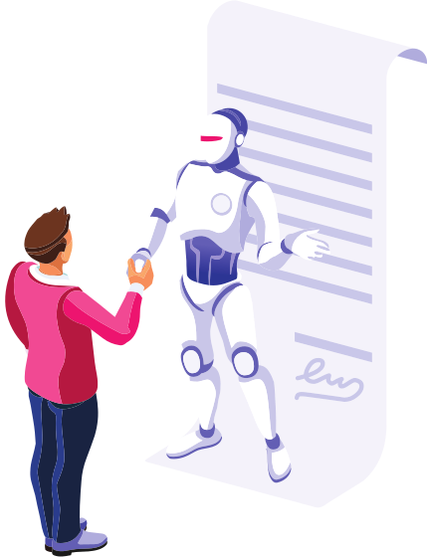
SMART CONTRACT
A smart contract is a computer program or a transaction protocol which is intended to automatically execute, control or document legally relevant events and actions according to the terms of a contract or an agreement.

Slide 22

WHAT IS ETH 2.0
Ethereum 2.0, also known as Eth2 or “Serenity,” is an upgrade to the Ethereum blockchain. The upgrade aims to enhance the speed, efficiency, and scalability of the Ethereum network so that it can process more transactions and ease bottlenecks.

Slide 23

BASICS OF SOLIDITY

Slide 24

Hackathon
Mint a set of NFTs.
Build a page which plays a video
The page can only be accessed if you own atleast one of the NFTs
Scan this to join the Discord Hackathon Community.

Slide 25
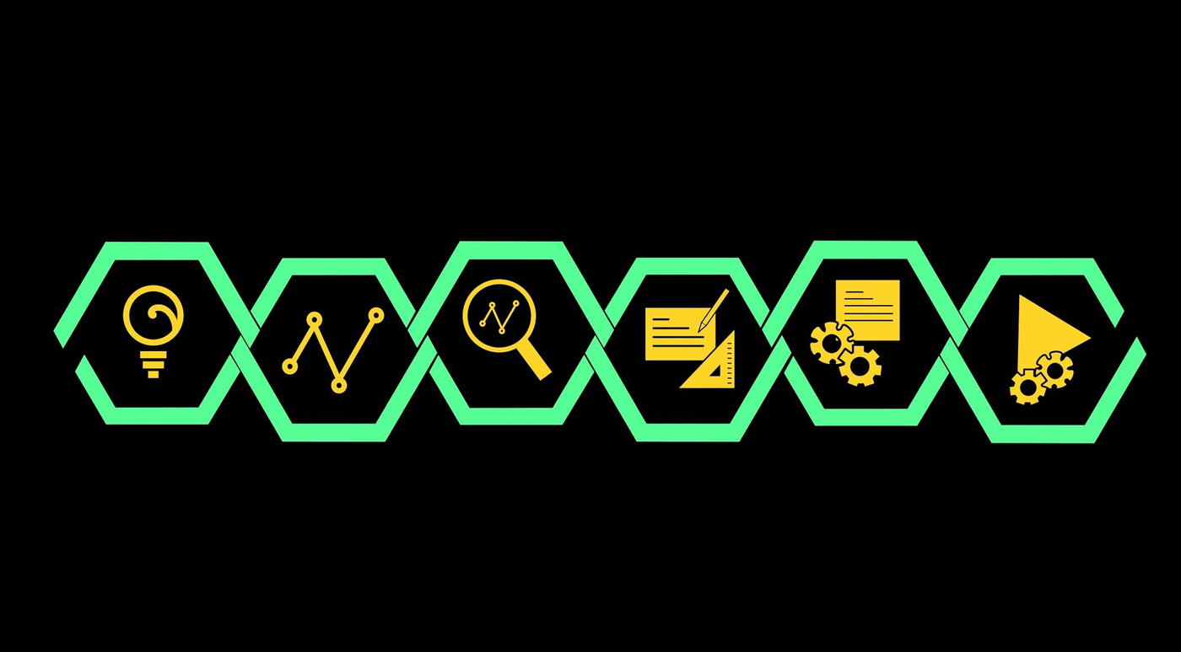

CONTACT US
FOR INQUIRIES
HEADQUARTERS
Goa & Gurgaon
EMAIL ADDRESS
nikhil.muzix@gmail.com
PHONE NUMBER
+91-8757850115

